Slide 1
실습 03
그래픽스

Slide 2
새로운 명령
matrix44.create_orthogonal_projection_matrix()
matrix44.create_from_translation()
glUniformMatrix4fv()
uniform mat4 model

Slide 3
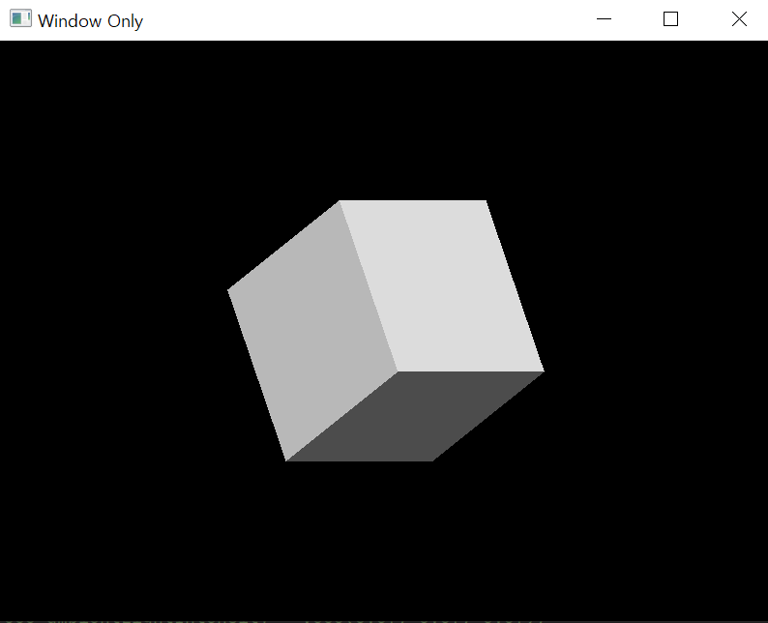
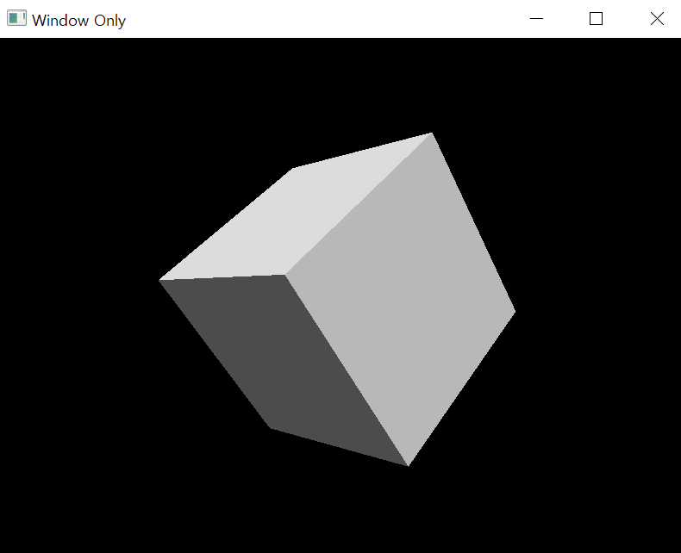
삼차원 Graphics
Orthographic
Perspective
matrix44.create_orthogonal_projection_matrix( -WORLD_SIZE*ar, WORLD_SIZE*ar, -WORLD_SIZE, WORLD_SIZE, -1.0, 10.0)
matrix44.create_perspective_projection_matrix(45.0, SCR_WIDTH / SCR_HEIGHT, 0.1, 100.0)

Slide 4
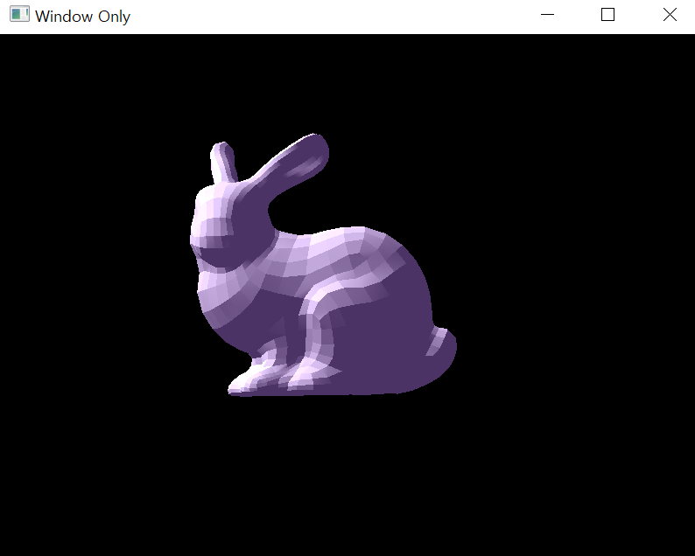
Object 파일 읽기
from ObjLoader import *
obj = ObjLoader()
obj.load_model("res/bunny.obj")
texture_offset =
len(obj.vertex_index) * 12
normal_offset = (texture_offset + len(obj.texture_index) * 8)
glBufferData(GL_ARRAY_BUFFER, obj.model.itemsize * len(obj.model), obj.model, GL_STATIC_DRAW)
glVertexAttribPointer(0, 3, GL_FLOAT, GL_FALSE, obj.model.itemsize * 3, ctypes.c_void_p(0))
glEnableVertexAttribArray(0)
glVertexAttribPointer(1, 3, GL_FLOAT, GL_FALSE, obj.model.itemsize * 3, ctypes.c_void_p(normal_offset))
glEnableVertexAttribArray(1)

Slide 5
Transform Matrix
rot_y = matrix44.create_from_y_rotation(0.8 * get_time())
scale = matrix44.create_from_scale(Vector3([0.45, 0.45, 0.45]))
matrix = matrix44.multiply(scale, rot_y)
trans = matrix44.create_from_translation(Vector3([-1.0, 0.0, 0.0]))
matrix = matrix44.multiply(matrix, trans)
TRANSFORM = ROTATE * SCALE * TRANS
projection * view * model * transform * vPosition;

Slide 6
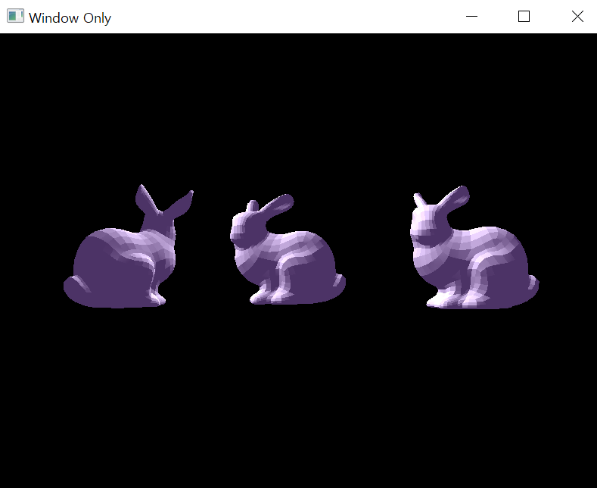
과제: Perspective Transform (Scale, Rotate, Trans) 를 한가지씩 이용하여 움직이는 Object 코드를 작성하시오.

Slide 7
과제 제출방법
학번_이름.py, 학번_이름.pdf 로 제출 - 보고서
(보고서에는 결과 사진-움직이는 영상 캡쳐, 소스코드만 넣기)
제출 기한: 수업 끝나는 시간까지 (10시 15분)

